Slide 1
Linear Regression & Correlation
Tom Vanasse

Slide 2
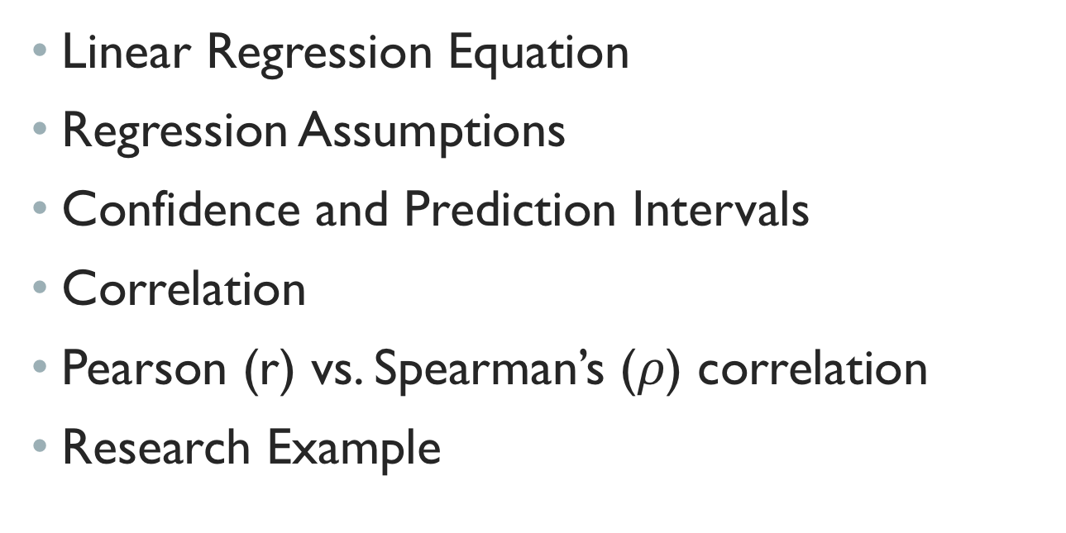
Outline
Linear Regression Equation
Regression Assumptions
Confidence and Prediction Intervals
Correlation
Pearson (r) vs. Spearman’s ($ρ$) correlation
Research Example

Slide 3
Brief History
Sir Francis Galton (1822-1911) and Karl Pearson’s (1857-1936) work on inherited characteristics of sweet peas led to the initial conceptualization of linear regression.¹
Subsequent efforts by Galton and Pearson brought about the more general techniques of multiple regression and the product-moment correlation coefficient.¹

Slide 4
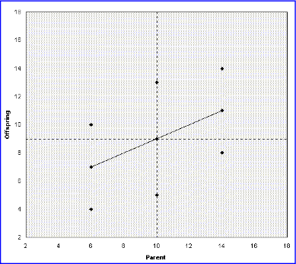
“In 1875, Galton had distributed packets of sweet pea seeds to seven friends; each friend received seeds of uniform weight but there was substantial variation across different packets. Galton's friends harvested seeds from the new generations of plants and returned them to him. Galton plotted the weights of the daughter seeds against the weights of the mother seeds.”¹
“Galton's original graph, illustrates how a line connecting the means of the columns of data points indicates the degree to which extreme values in the first generation (on the X-axis) tend to regress toward the mean of the second generation (on the Y-axis).”¹

Slide 5
Regression
Used to investigate relationships between continuous variables
Allows assessment of strengths of relationships in the data
Also allows determination of uncertainties in the models using confidence intervals

Slide 6
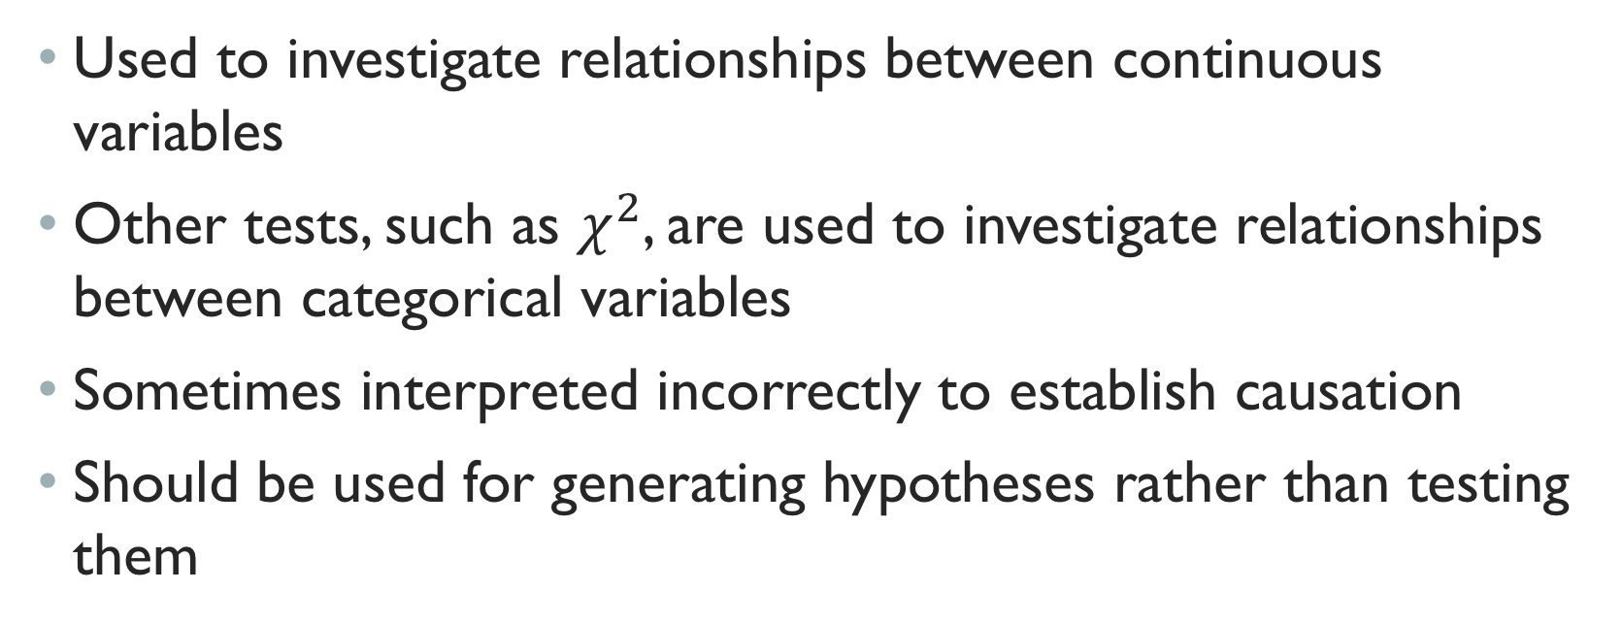
Correlation
Used to investigate relationships between continuous variables
Other tests, such as $χ^{2}$, are used to investigate relationships between categorical variables
Sometimes interpreted incorrectly to establish causation
Should be used for generating hypotheses rather than testing them

Slide 7
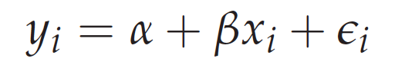
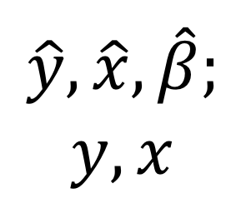
Linear Regression Equation
$$\hat{y}, \hat{x},\hat{β};$$
$$y,x$$

Slide 8
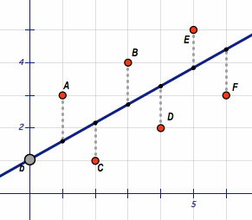
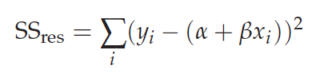
Least SquAres FitTING
Reducing “error”, as measure by the summation of squared residuals
note the point it is pivoting around

Slide 9
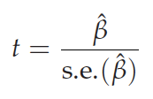
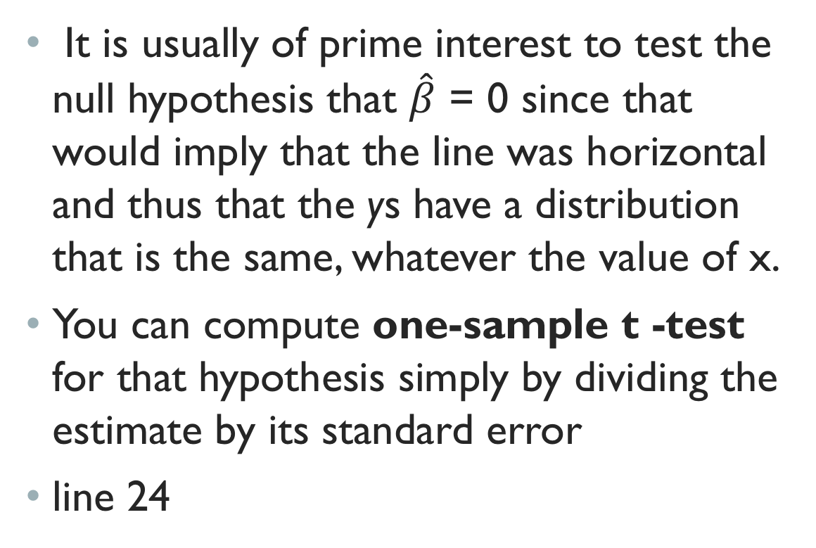
significance
It is usually of prime interest to test the null hypothesis that $\hat{β}$ = 0 since that would imply that the line was horizontal and thus that the ys have a distribution that is the same, whatever the value of x.
You can compute one-sample t -test for that hypothesis simply by dividing the estimate by its standard error
line 24

Slide 10
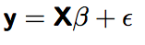
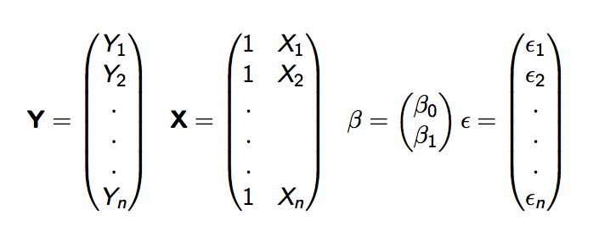
Matrix notation (Simple Regression)
Two parameters, p = 2
Notes:
Draw example of calculating Y1 on board.

Slide 11
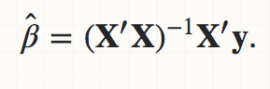
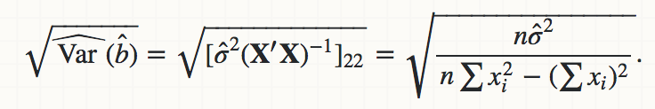
More Matrix Notation…
For more information, see reference 10
se_beta.R (code example)

Slide 12
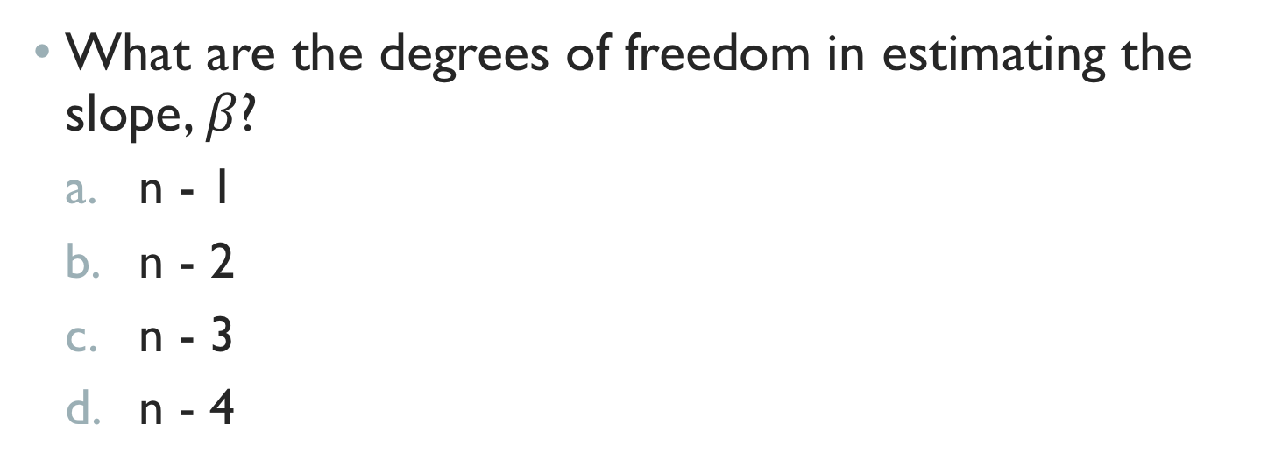
Quiz question 1
What are the degrees of freedom in estimating the slope, $β$?
n - 1
n - 2
n - 3
n - 4

Slide 13
Answer Quiz Queston 1 (B)
one way of thinking about the n-2 df is that it's because we use 2 means to estimate the slope coefficient (the means of Y and X)
df from Wikipedia: "...In general, the degrees of freedom of an estimate of a parameter are equal to the number of independent scores that go into the estimate minus the number of parameters used as intermediate steps in the estimation of the parameter itself ."

Slide 14
Assumptions for Linear Regression
Linearity of the relationship between dependent and independent variables
Independence of the errors (no serial correlation)
Normality of the error distribution.
Homoscedasticity (constant variance) of the errors

Slide 15
Anscombe's quartet
Comprises four datasets that have nearly identical simple descriptive statistics, yet appear very different when graphed.
Always plot the data!
Reference 9

Slide 16
Independence of Errors
Independence of the errors
e.g., no serial correlation
serial – here refers to time or space!
one residual isn’t influenced by the previous residual

Slide 17
Reference 2

Slide 18
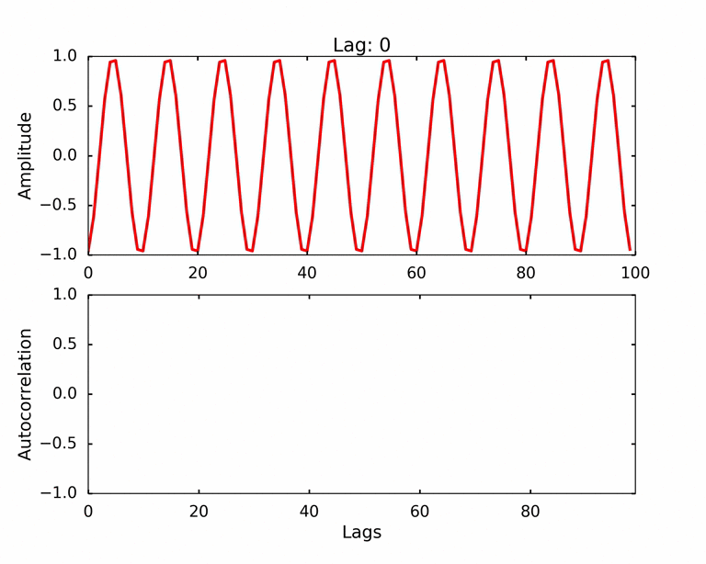
Independence of Errors
Reference 3

Slide 19
Independence OF ERRORs

Slide 20
Normality
Reference 2

Slide 21
Homoscedasticity
That's a basic visual diagnostic of the spread of standardized (for model-variance) residuals against fitted values, which is suitable for seeing if there's variability related to the mean (not already accounted for by the model). If the assumption of homoscedasticity is true, we should see roughly constant spread. In this case the indication of increase with fitted values is fairly mild.

Slide 22
Reference 2
The y-axis is the square root of the standardized residuals, which are residuals rescaled so that they have a mean of zero and a variance of one; note that all values are positive. This plot eliminates the sign on the residual, with large residuals (both positive and negative) plotting at the top and small residuals plotting at the bottom.
Notes:
The y-axis is the square root of the standardized residuals, which are residuals rescaled so that they have a mean of zero and a variance of one; note that all values are positive. This plot eliminates the sign on the residual, with large residuals (both positive and negative) plotting at the top and small residuals plotting at the bottom.

Slide 23
Cooks Distance
Data points with large residuals (outliers) and/or high leverage may distort the outcome and accuracy of a regression.
Cook's distance measures the effect of deleting a given observation.
Points with a large Cook's distance are considered to merit closer examination in the analysis.

Slide 24
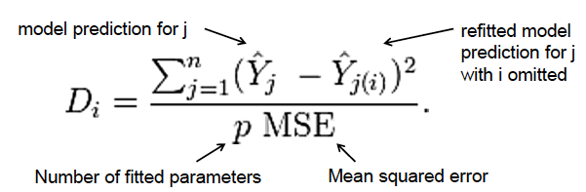
Cooks Distance

Slide 25
Reference 2
Line 54

Slide 26
Confidence & Prediction intervals
Both confidence intervals and prediction intervals in regression take account of the fact that the intercept and slope are uncertain - you estimate the values from the data, but the population values may be different (if you took a new sample, you'd get different estimated values).

Slide 27
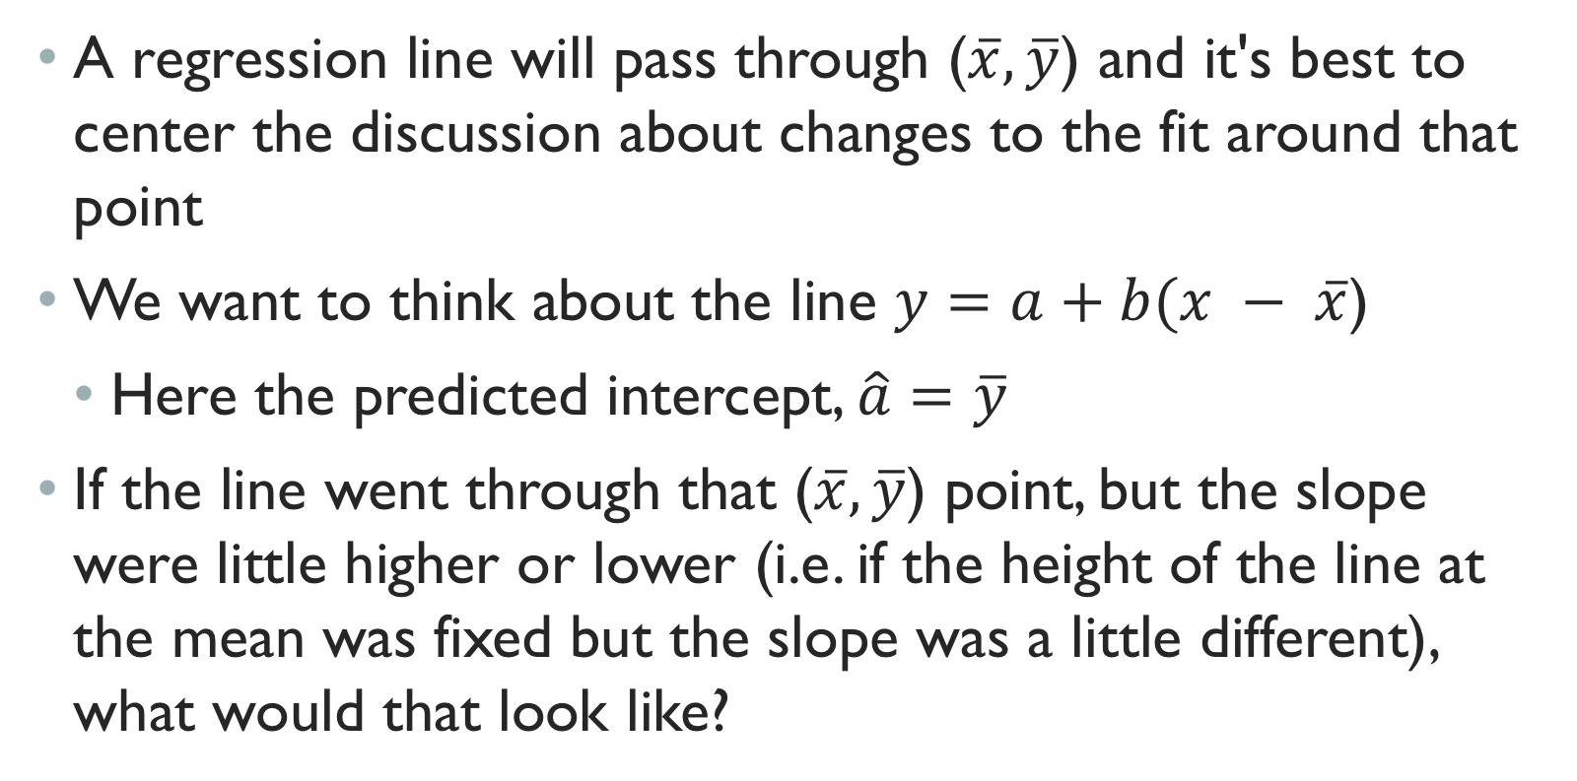
Mean
A regression line will pass through ($\overline{x},\overline{y}$) and it's best to center the discussion about changes to the fit around that point
We want to think about the line $y=a+b(x − \overline{x}$)
Here the predicted intercept, $\hat{a}=$ $\overline{y}$
If the line went through that ($\overline{x},\overline{y}$) point, but the slope were little higher or lower (i.e. if the height of the line at the mean was fixed but the slope was a little different), what would that look like?

Slide 28
Reference 2

Slide 29
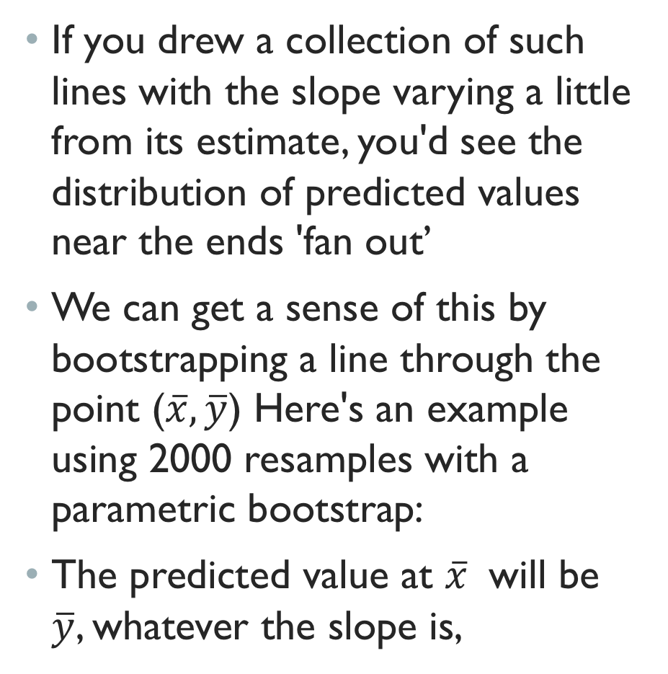
If you drew a collection of such lines with the slope varying a little from its estimate, you'd see the distribution of predicted values near the ends 'fan out’
We can get a sense of this by bootstrapping a line through the point ($\overline{x},\overline{y}$) Here's an example using 2000 resamples with a parametric bootstrap:
The predicted value at $\overline{x}$ will be $\overline{y}$, whatever the slope is,
Reference 2

Slide 30
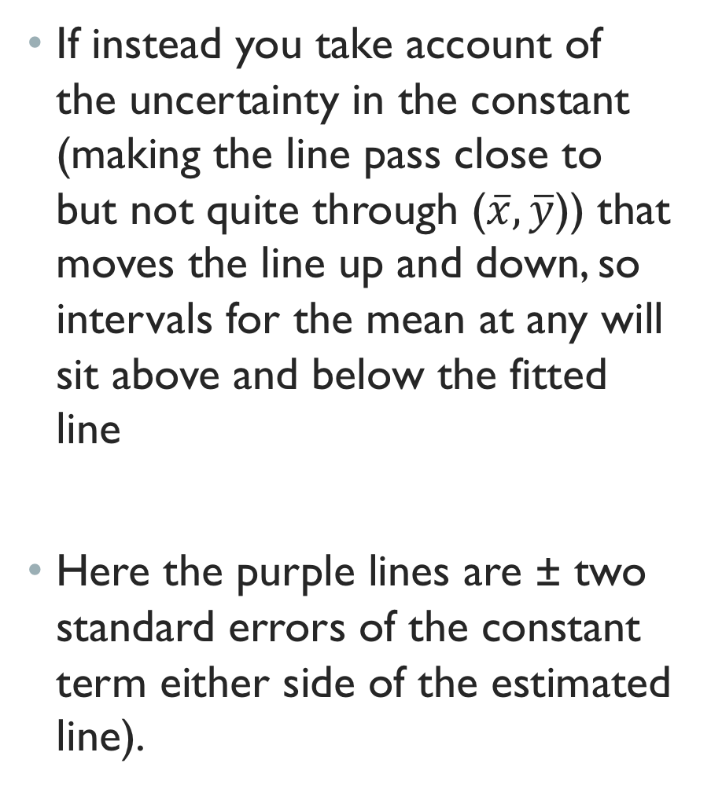
If instead you take account of the uncertainty in the constant (making the line pass close to but not quite through ($\overline{x},\overline{y}$)) that moves the line up and down, so intervals for the mean at any will sit above and below the fitted line
Here the purple lines are ± two standard errors of the constant term either side of the estimated line).
Reference 2

Slide 31
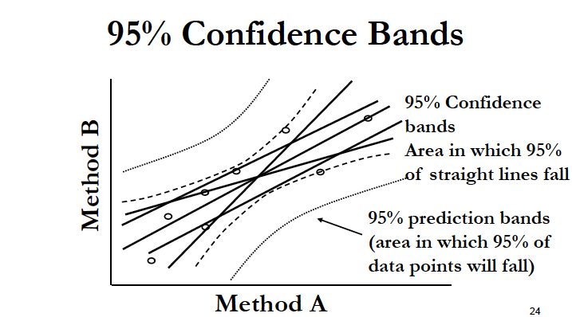
line 75

Slide 32
Deming Regression
Deming regression, named after W. Edwards Deming, differs from the simple linear regression in that it accounts for errors in observations on both the x- and the y- axis

Slide 33
Deming Regression
x*,y* denotes “true” values of regression, x,y are observed values.
Ratio of variances (default is one):
line 109

Slide 34
Correlation

Slide 35
Pearson Correlation
In some experiments, two variables are measured that change together, however neither can be considered to be the dependent variable
The correlation coefficient is a number between -1 and +1 that describes the strength of this association

Slide 36
Pearson Correlation
Most commonly used
Quantifies the strength of association between two variables that are normally distributed:

Slide 37
Pearson Correlation
Alternatively, the mean product of standard scores

Slide 38
Coefficient of Determination (Explained Variance)

Slide 39
CORRELATION VS. regression
Correlation calculations do not find a best fit line but quantify how much one variable changes with another.
It doesn’t matter which variable is X and which is Y, the correlation will be the same.
Linear regression finds the line that best predicts Y given X.
Choice of which variable to label Y and which to call X will impact the results.

Slide 40
Spearman Correlation,
The Spearman correlation coefficient is defined as the Pearson correlation coefficient between the ranked variables.

Slide 41

Monotonicity
Spearman correlation assesses how well the relationship between two variables can be described using a monotonic function.

Slide 42
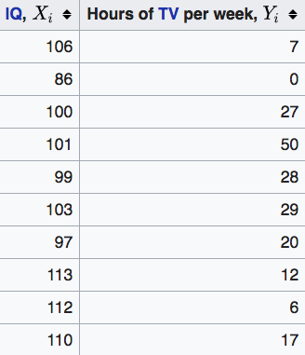
Example
Reference 6

Slide 43
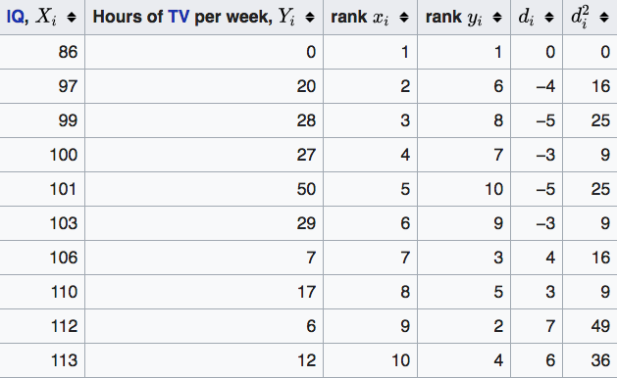
Example
−0.175
line 123
Reference 6

Slide 44
Quiz Question 2
Which correlation is greater in this example?
Spearman
Pearson
Reference 6

Slide 45
Question 2 answer (a)

Slide 46
Research
Resting-state functional MRI
51 PTSD subjects, 29 trauma-exposed controls, 25 healthy controls
Independent Components Analysis (ICA)
identifies distinct regions that “co-fluctuate” in spontaneous neural activity

Slide 47
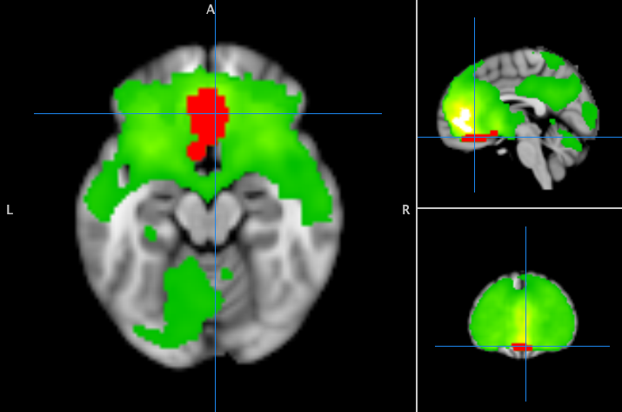
Group ICA
Two-sample, two-sided t-test of network connectivity
PTSD vs. HC
PTSD vs. TEC
TEC vs. HC
Red: PTSD > HC
Uncorrected p < 0.001
Cluster-level p < 0.01

Slide 48
Post-hOc Correlation
Do these network alterations get worse with PTSD symptoms?
line 154

Slide 49
Summary
Linear regression allows one to estimate a linear relationship between a dependent and independent variable.
Correlation coefficients allow the assessment of association between two variables if a dependent independent relationship is not evident.
Pearson method is used for numerical data
Spearman method is used for ranked data

Slide 50
Slides/Code
https://github.com/tvanasse/Class-Demo-6-30-18

Slide 51
References
¹Stanton JM (2001): Galton, Pearson, and the Peas: A Brief History of Linear Regression for Statistics Instructors. Journal of Statistics Education 9:255.
²http://data.library.virginia.edu/diagnostic-plots/
³http://qingkaikong.blogspot.com/2017/01/signal-processing-how-autocorrelation.html
⁴https://stats.stackexchange.com/questions/85560/shape-of-confidence-interval-for-predicted-values-in-linear-regression
⁵https://en.wikipedia.org/wiki/Deming_regression
⁶https://en.wikipedia.org/wiki/Spearman%27s_rank_correlation_coefficient
⁷https://en.wikipedia.org/wiki/Coefficient_of_determination
⁸https://www.otexts.org/fpp/5/4
⁹https://en.wikipedia.org/wiki/Anscombe%27s_quartet#/media/File:Anscombe%27s_quartet_3.svg
¹⁰https://stats.stackexchange.com/questions/44838/how-are-the-standard-errors-of-coefficients-calculated-in-a-regression/44841#44841

